Slide 1
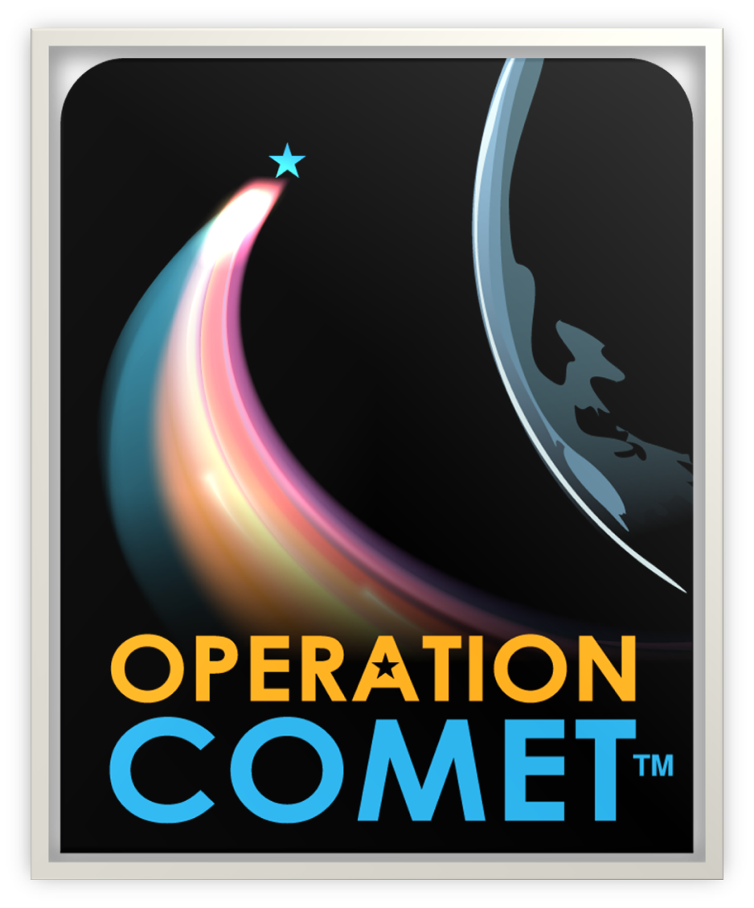
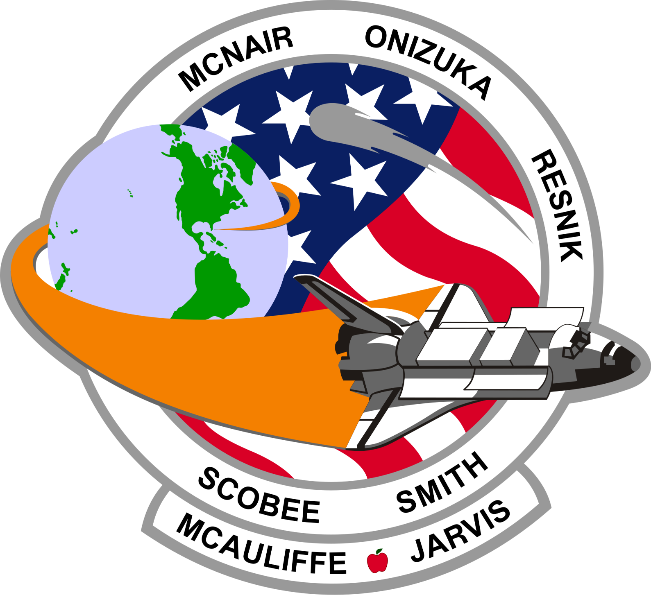
Notes:
After several previous failed attempts, the crew is tasked with a mission to observe, research, and analyze long-period comets that have entered our solar system. Astronauts in both Mission Control and Spacecraft conduct experiments to study comets to help scientists better understand how they are formed and how they could potentially impact Earth. During the mission, however, a shocking discovery is made, and the crew must brainstorm together to solve the emergency, ensuring the safety of the crew and the success of the mission.

Slide 2
GOAL: Study Long-Period Comets
Orbital periods are over 200 years
Difficult to study due to the length of their orbital periods
Easier to study when closer to Earth
May provide scientists with new insight into how early planets were formed
Notes:
Long-period comet:
From Oort Cloud, outer edge of the solar system that is 50x farther away from the Sun than the Kuiper Belt.
Highly eccentric orbits!
Take between 200 years to millions of years to orbit the Sun.

Slide 4
Mission Control Team
The Mission Control Team is responsible for ensuring the safety of the crew. Flight Director oversees the Mission Control.
Notes:
With a permanent human presence aboard the International Space Station, 9 teams of highly trained and experienced engineers and technicians (students) are on duty 7 days a week, 24 hours a day, 365 days a year. Flight controllers keep a constant watch on the crew’s activities and monitor spacecraft systems, crew health and safety as they check every system to ensure operations proceed as planned. These highly trained flight controllers have the skills needed to closely monitor and maintain increasingly complex missions and to respond to unexpected events. Located at 1601 E NASA Pkwy in Houston, the ISS Mission Control is an addition from NASA Johnson Space Center. For the storyline, I had to place the ISS Mission Control in Cape Canaveral, Florida!

Slide 5
Spacecraft Team
The Spacecraft Crew is responsible for conducting experiments to fulfill the mission objectives. They are joining the International Space Station using an Atlas V rocket topped by the CST-100 Starliner. Mission Commander oversees the Spacecraft.
Notes:
Flying to the International Station, 9 teams of students will conduct experiments and build and program a Remote Operated Vehicle (ROV) to fulfill their objectives to learn more about the long-period comet.
The crew is in the CST-100 Starliner, a mix of crew and cargo, for missions to low-Earth orbit or for NASA service missions to the International Space Station! It is designed for a land-based return and can be reused up to 10 times. The CST-100 Starliner is attached to the Atlas V rocket and is approximately 172 ft high. They are leaving from Cape Canaveral, Florida.

Slide 6
International Space Station
The International Space Station is the largest modular space station in low Earth orbit.
It serves as a microgravity and space environment research laboratory in which scientific research is conducted in physics, astrobiology, meteorology, and astronomy.
Notes:
A spacecraft can arrive at the space station as soon as 4 hours after launching from Earth.
A crew of 7 people live and work while orbiting Earth about every 90 minutes.
That makes 16 sunrises and sunsets or 16 orbits around the Earth in 24 hours.
The space station travels an equivalent distance to the Moon and back in about a day.
More than 50 computers control the systems in the space station and 8 miles of wire connects the electrical power system aboard the space station.
The living and working space in the station has 6 sleeping quarters, 2 bathrooms, a gym, and a 360-degree view bay window.
The space station is 356 feet end-to-end, the full length of an American football field!
To mitigate the loss of muscle and bone mass in the human body in microgravity, astronauts work out at least 2 hours a day.

Slide 7
Milestones
Safely Return Crew to Earth
Launch ROV to Collect Data from Long-Period Comets
Search for
Long-Period Comets
SPACECRAFT
Conduct Experiments on Space Station
Launch Crew
Aboard Atlas V
MISSION CONTROL:
Monitor the Health and Safety of the Crew
Collect Data
Conduct Tests and Experiments
Monitor Internal Environment: Radiation, Air Quality, and Life Support Needs
Monitor External Environment: Solar Flares and Space Debris

Slide 8
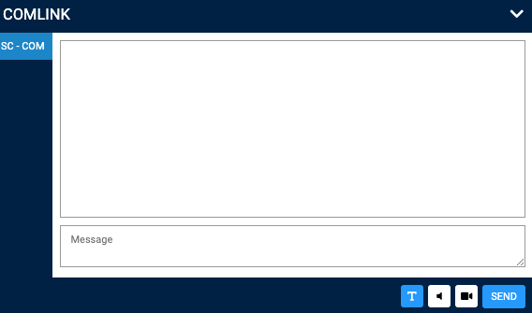
Computer’s Interface
Station Tools
Notes
Messaging
Notes:
Notes: you can take notes throughout the mission.
Station Tools: lists of the tasks that must be completed. The lesson will pop up on the screen once you click on it!
Messaging (or, also called, COMlink) has text and audio connection capabilities:
Text, move your cursor over the COMLINK tab at the bottom right of your screen. Select MC or SC COM ONLY and make sure to select T. Type or copy/paste your message and then click send. It is very important that you send all messages to the appropriate COM team. If you are in Spacecraft, you will send messages to SC COM. If you are in Mission Control, you will send messages to MC COM.
ROV will need to connect via audio. They will click the button that looks like a speaker and click connect. You’ll then need to wait for your teammate to connect.
Play the video slide 9 to learn how to send a message to COM Officer.

Slide 9
How to send a Text Message
Notes:
Crew Member View

Slide 10
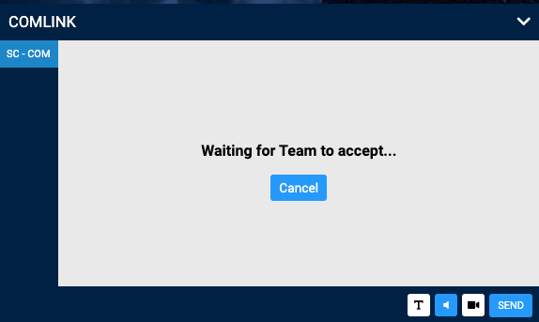
How to use the communication device (headset)
STEP 1
Click on the speaker logo
Click on Connect
STEP 2
Wait for your partner to accept your call!

Slide 11
Helpful Tools
Dictionary
If you click on a scientific or technical word underlined in blue, you will have access to its definition!
Read Aloud (through Headset)
If you would like to hear what is on your screen, put your headsets on and click on Read Page! It will read the page for you!
Notes:
A spacecraft can arrive at the space station as soon as 4 hours after launching from Earth.
A crew of 7 people live and work while orbiting Earth about every 90 minutes.
That makes 16 sunrises and sunsets or 16 orbits around the Earth in 24 hours.
The space station travels an equivalent distance to the Moon and back in about a day.
More than 50 computers control the systems in the space station and 8 miles of wire connects the electrical power system aboard the space station.
The living and working space in the station has 6 sleeping quarters, 2 bathrooms, a gym, and a 360-degree view bay window.
The space station is 356 feet end-to-end, the full length of an American football field!
To mitigate the loss of muscle and bone mass in the human body in microgravity, astronauts work out at least 2 hours a day.

Slide 12
Lights and Sounds
Space is dangerous! The Mission Commander will trigger loud sound effects and flashing lights in case of an emergency during the mission.

Slide 13
Team Responsibilities: Health and Safety
MEDICAL
Monitors the crew’s health
LIFE SUPPORT
Monitors the environmental conditions
COMMUNICATIONS
Establishes and maintains constant communication

Slide 14
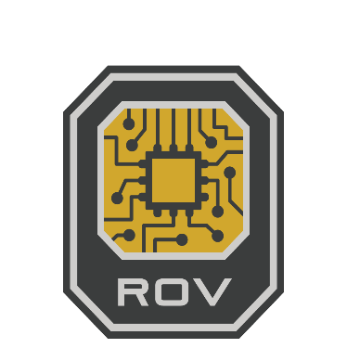
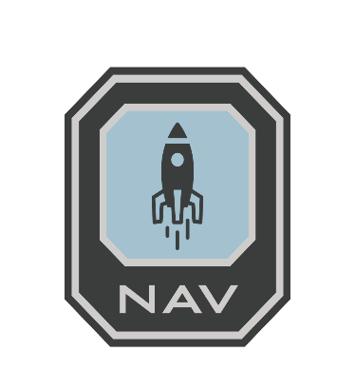
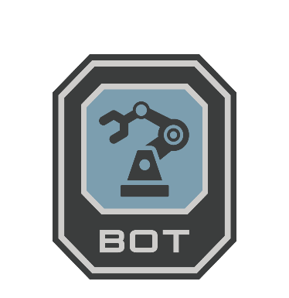
Team Responsibilities: Rover Assembly and Launch
REMOTELY OPERATED VEHICLE
Designs the ROV to investigate comet properties
NAVIGATION
Monitors spacecraft orbital trajectory
ROBOTICS
Programs ROV components

Slide 15
Team Responsibilities: Testing and Research
BIOLOGY
Investigates impact of space on human body functions
GEOLOGY
Analyzes the geologic properties of comet samples
WEATHER
Investigates comets using telescopes

Slide 16
© 2020 Challenger Center for Space Science Education, Inc.
All Rights Reserved.
Version: May 2021

